Slide 1
Mobile Application Development - Day 4
Click Events
Intent

Slide 2
Click Events
When the user clicks a button, the Button object receives an on-click event.
XML
Programatically
Activity

Slide 3
Click Events - XML
Add the android:onClick attribute to the <Button> element in your XML layout.
android:onClick=”value”
The value for this attribute must be the name of the method you want to call in response to a click event.
Eg
android:onClick=”userLogin”

Slide 4
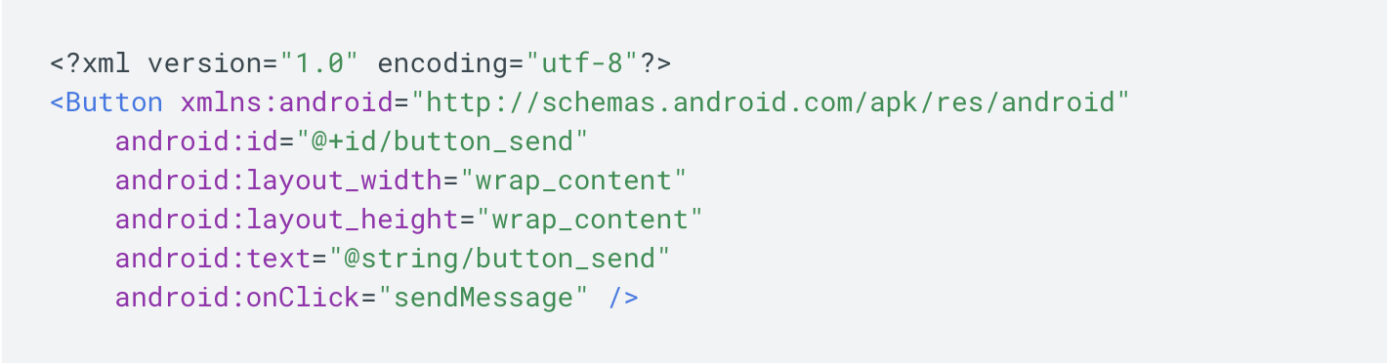
Click Events - XML

Slide 5
Click Events - XML
Within the Activity that hosts this layout, the following method handles the click event:
/** Called when the user touches the button */
public void sendMessage(View view) {
// Do something in response to button click
}

Slide 6
Click Events - XML
The method you declare in the android:onClick attribute must have a signature exactly as shown above. Specifically, the method must:
Be public
Return void
Define a View as its only parameter (this will be the View that was clicked)

Slide 7
Click Events - Activity
You can also declare the click event handler programmatically rather than in an XML layout.
Create an View.OnClickListener object
Assign it to the button by calling
setOnClickListener(View.OnClickListener)

Slide 8
Click Events - Activity
Button button = (Button) findViewById(R.id.button_send);
button.setOnClickListener(new View.OnClickListener() {
public void onClick(View v) {
// Do something in response to button click
}
});

Slide 9
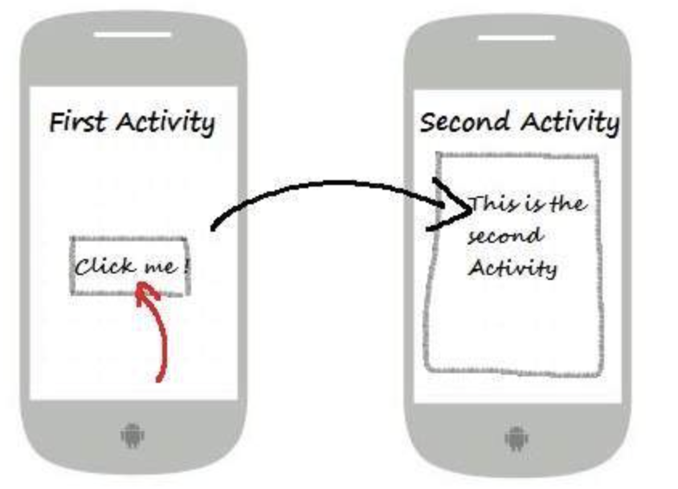
Intents

Slide 10
Intent - Switch Activity
Intent intent = new Intent(FirstActivity.this,SecondActivity.class);
startActivity(intent);

Slide 11
Intent - Switch and Send Data
Intent intent = new Intent(FirstActivity.this,SecondActivity.class);
intent.putExtra(“key_1” , “value_1”);
intent.putExtra(“key_2” , “value_2”);
startActivity(intent);

Slide 12
Intent - Receive Data
Intent intent = getIntent();
String key1 = intent.getStringExtra("key_1");
String key2 = intent.getStringExtra("key_2");

Slide 13
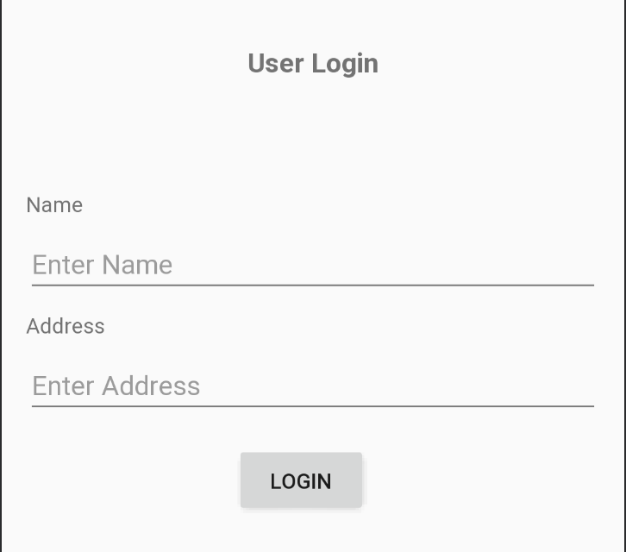
Sample

Slide 14
Sample Question
Explain intent. Write a sample program to switch activity. [5]
Write a sample program to pass data between activity. Show to received data in toast. [10]

